Slide 1
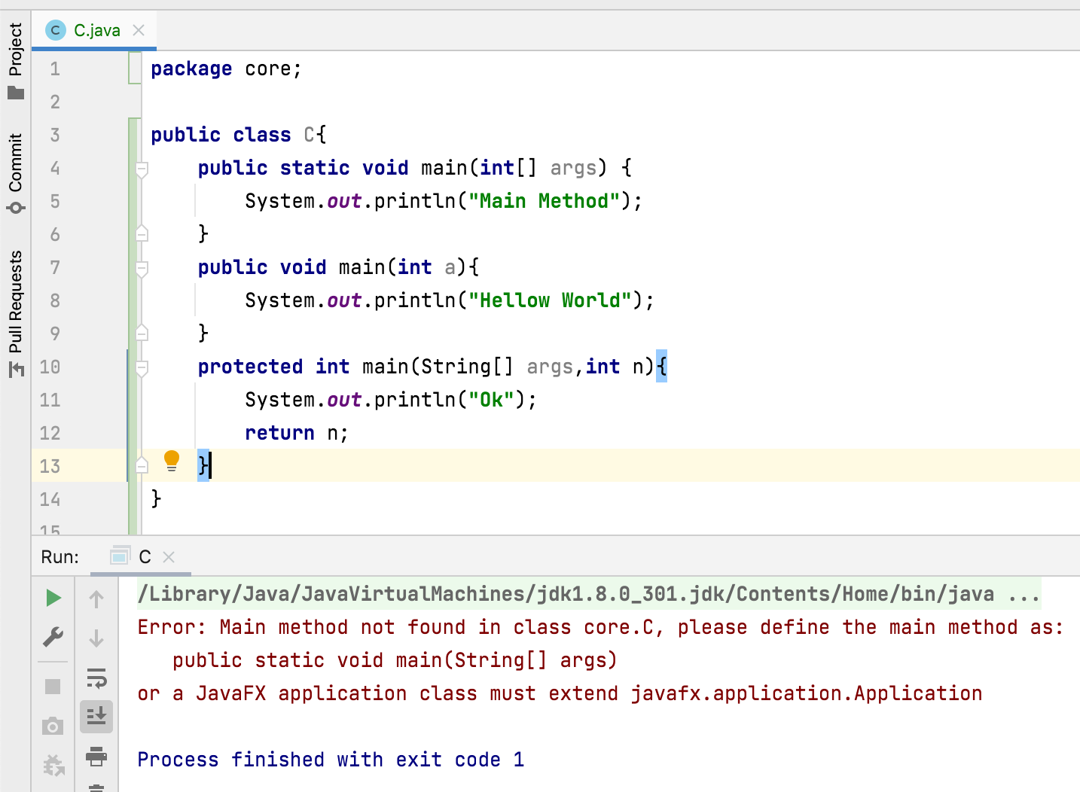
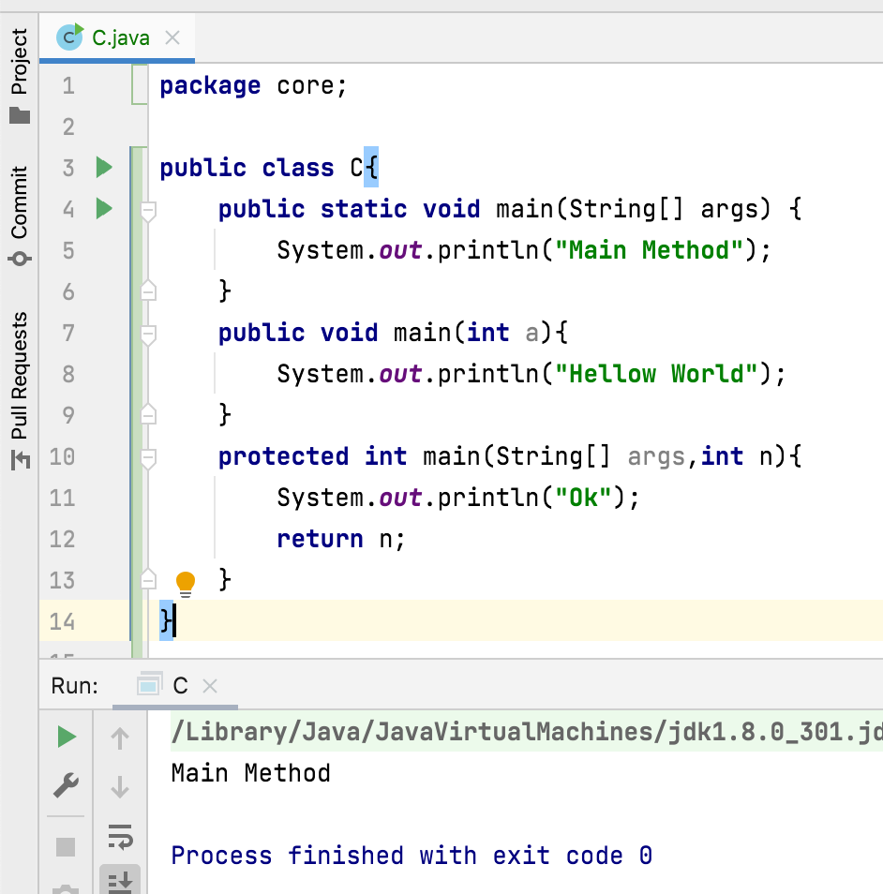
Can we overload main() method?
Yes, we can overload main() method.
A Java class can have any number of main() methods.
But to run, class should have main() method with signature as public static void main(String[] args).
If we do any modification to this signature, then:
Compilation: no error
Run : error ”main method not found”.

